Slide 1
HEART DISEASE PREDICTION MODEL
BY – EMILY BHATTACHARJEE
USING LOGISTIC REGRESSION

Slide 2

PROBLEM STATEMENT
01
Heart disease is a major global health concern.
Early prediction helps reduce risks and improve
treatment.
Manual diagnosis takes time and depends on
expert interpretation.
Objective: Predict the likelihood of heart disease using
machine learning.

Slide 3

IDEA SOLUTION
02
Build a Logistic Regression model using patient health data.
Perform exploratory data analysis to understand key features
Train and test the model for accuracy
Provide an interactive prediction system for user inputs.

Slide 4






TECHNOLOGIES USED
03
Python : Python Programming Language
NumPy – Numerical Computation
Pandas – Data loading & Preprocessing
Matplotlib – Graphs & EDA
Scikit-Learn – Splitting, Modeling, Evaluation
Model Used: Logistic Regression
Environment: Jupyter Notebook

Slide 5
LOGISTIC REGRESSION(WHAT AND WHY)
04
BINARY CLASSIFICATION
Logistic regression is a statistical method used for binary classification problems, predicting the probability that a given input point belongs to a particular category. This technique is essential for distinguishing between two possible outcomes, such as the presence or absence of heart disease, enabling informed healthcare decisions through predictive analytics
SIGMOID FUNCTION
The sigmoid function is crucial in logistic regression, transforming any real-valued number into a value between 0 and 1. This property makes it ideal for modeling probabilities. By applying a threshold, we can classify predicted probabilities into binary outcomes, allowing healthcare professionals to make objective assessments based on statistical data.
THEORY
A classification algorithm used for predicting binary outcomes.
Uses the sigmoid function to output probabilities between 0 and 1.
Probability ≥ 0.5 → Heart disease present. Probability < 0.5 → Heart disease absent

Slide 6
WORKFLOW
05
Load and inspect dataset
Preprocess and clean data
Exploratory Data Analysis (graphs & insights)
Define features (X) and target (y)
Interactive user prediction
Evaluate model performance
Train Logistic Regression model
Split data into training/testing

Slide 7
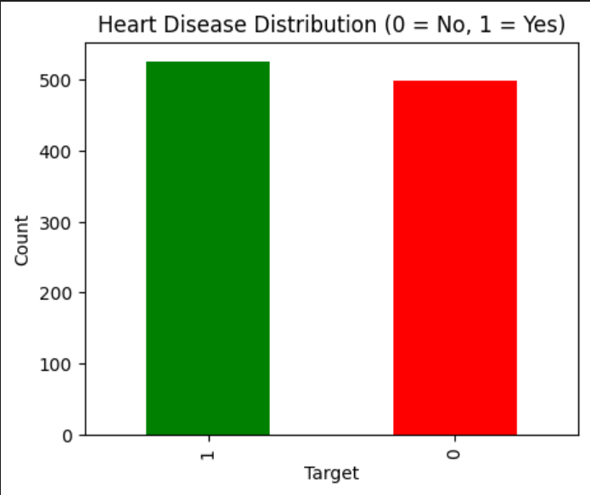
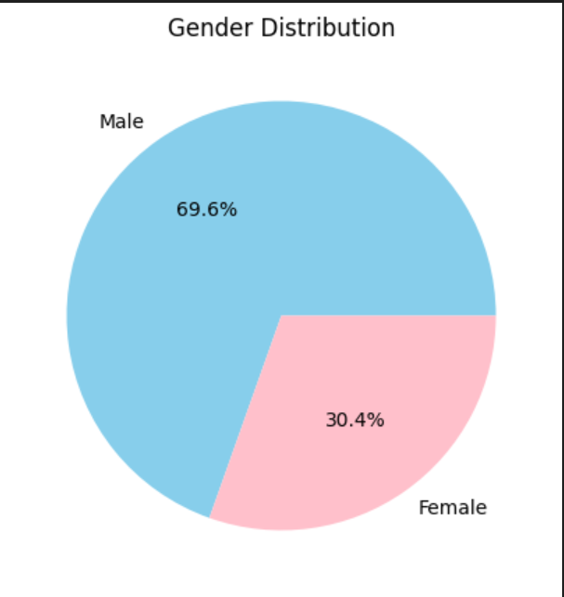
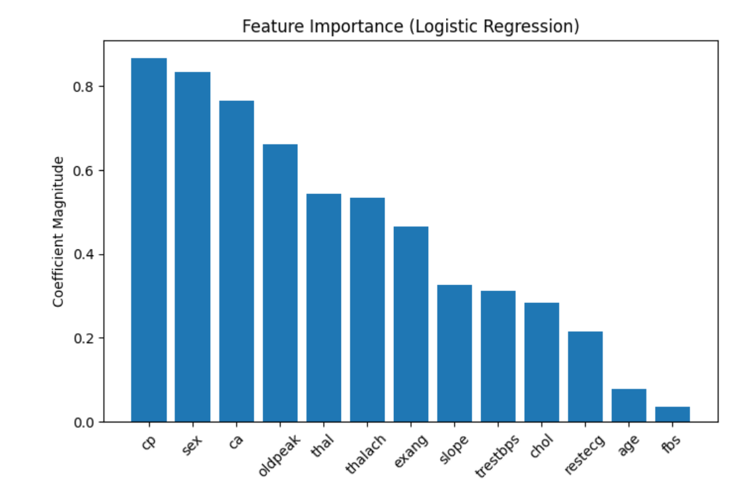
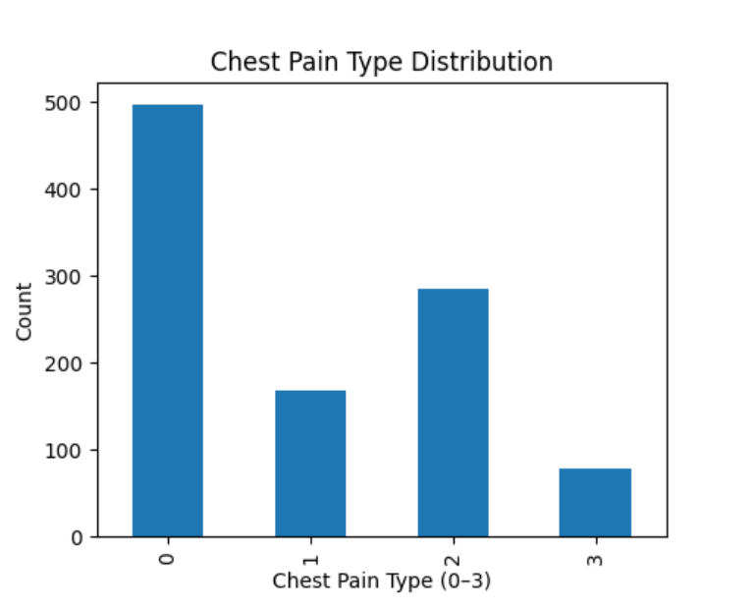
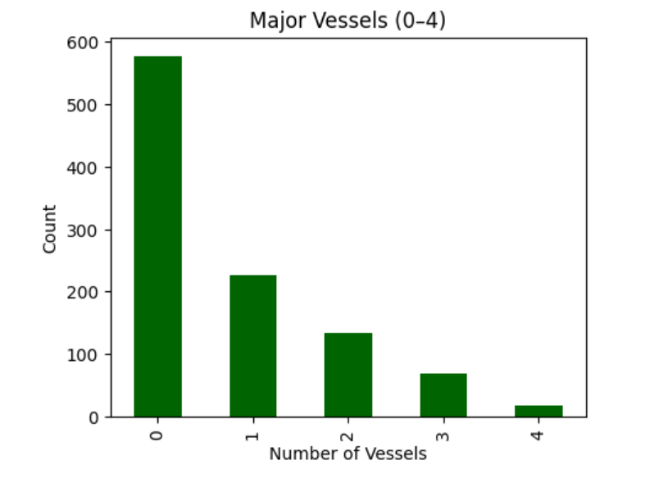
EDA HIGHLIGHTS
06

Slide 8
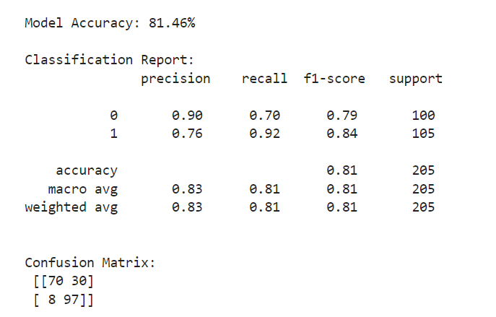
MODEL EVALUATION AND CONCLUSION
07
Model Evaluation:
Accuracy Score: 81.46%
Confusion Matrix :
Classification Report :
Future Scope:
Adding frontend for user-facing predictions.
Using advanced models (Random Forest, SVM, XGBoost).
Deploying the model as a web or mobile tool.
Conclusion:
Successfully built a logistic regression model for heart disease prediction.
EDA revealed key medical factors influencing disease.
Model shows good accuracy and interpretability.

Slide 9
THANK YOU!
EMAIL :emily231001001233@technoindiaeducation.com
GITHUB:https://github.com/Emily-bhat/Heart-Disease-Prediction-Model

